Slide 1


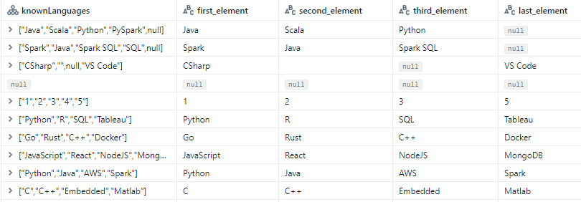

How to extract specific elements of array, map?
element at()

